Slide 1
Construction of a Straw Bale Home in Central VA

Slide 2
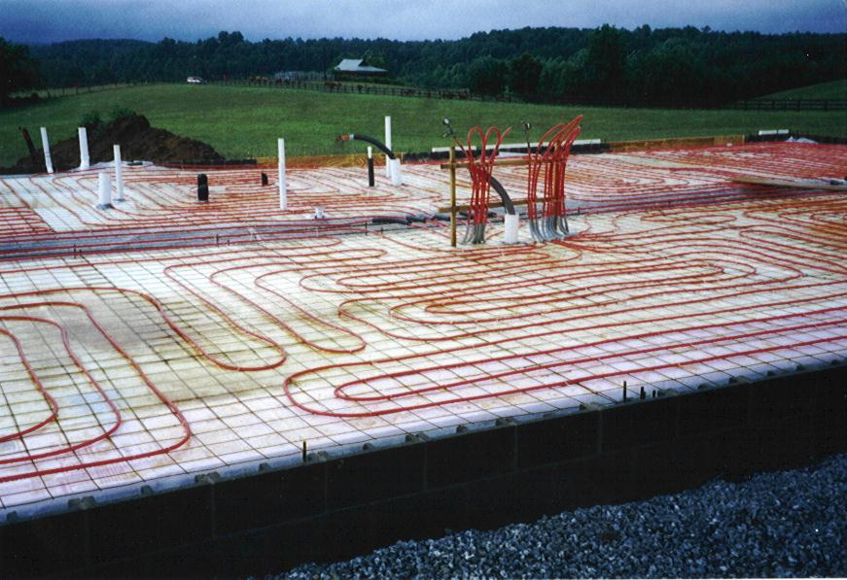
Radiant heating system coils laid out on floor

Slide 3
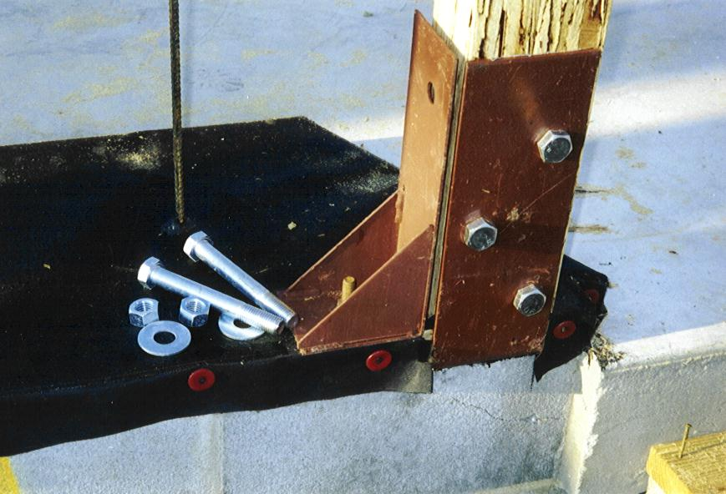
Post-and-Beam Construction Detail

Slide 4
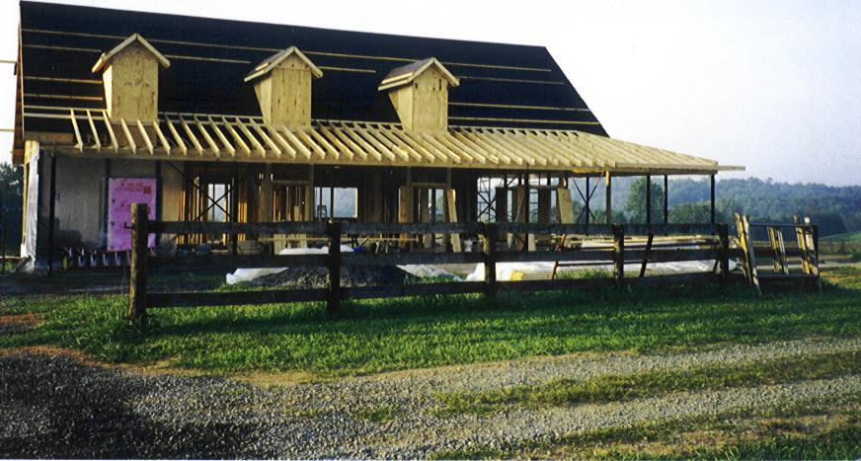
Framed-In House

Slide 5
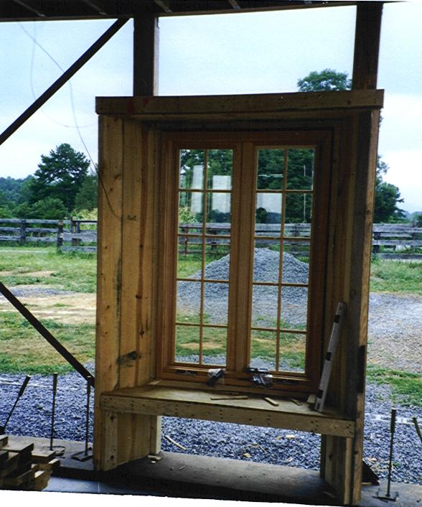

Slide 6
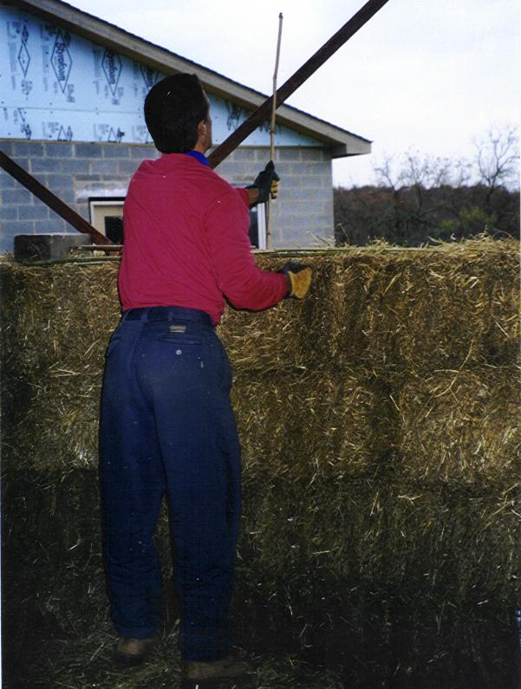

Slide 7
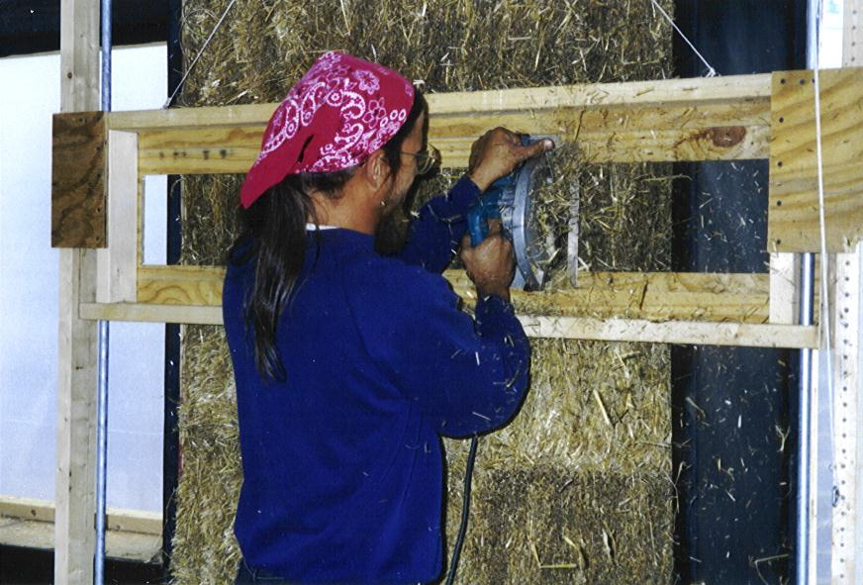

Slide 8
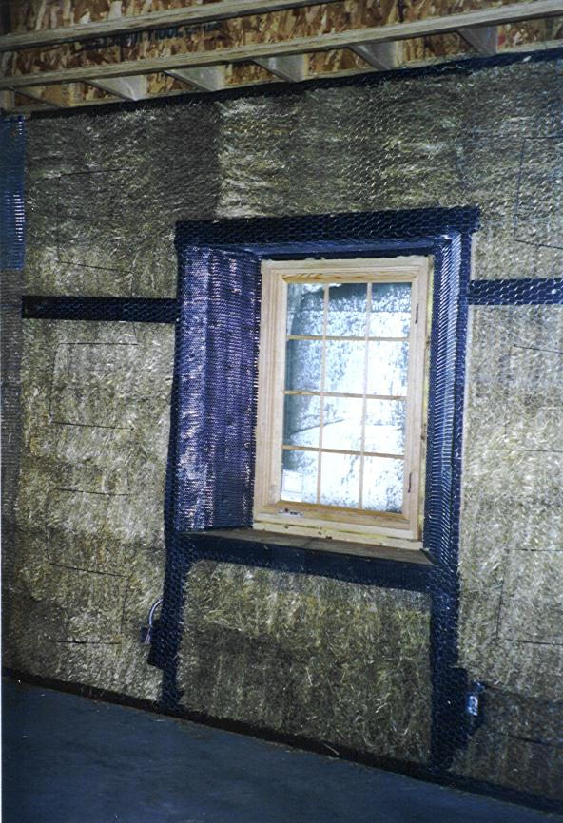

Slide 9
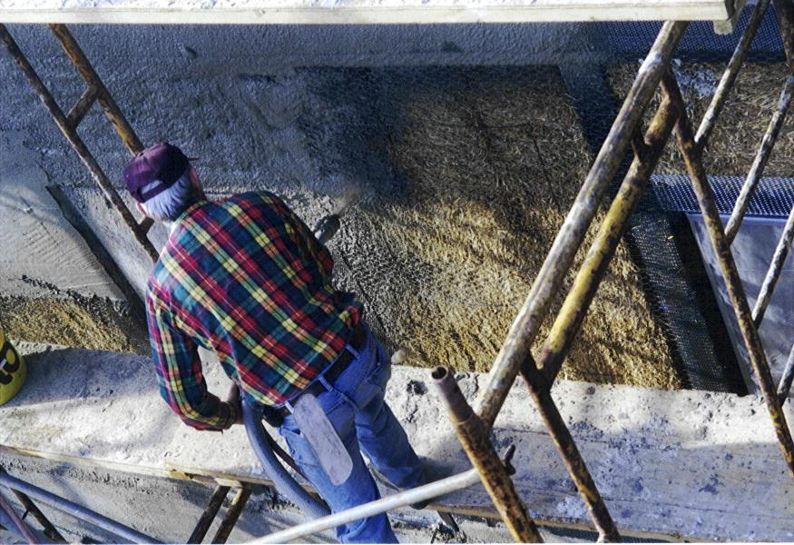
Applying Stucco to Outside Surface

Slide 10
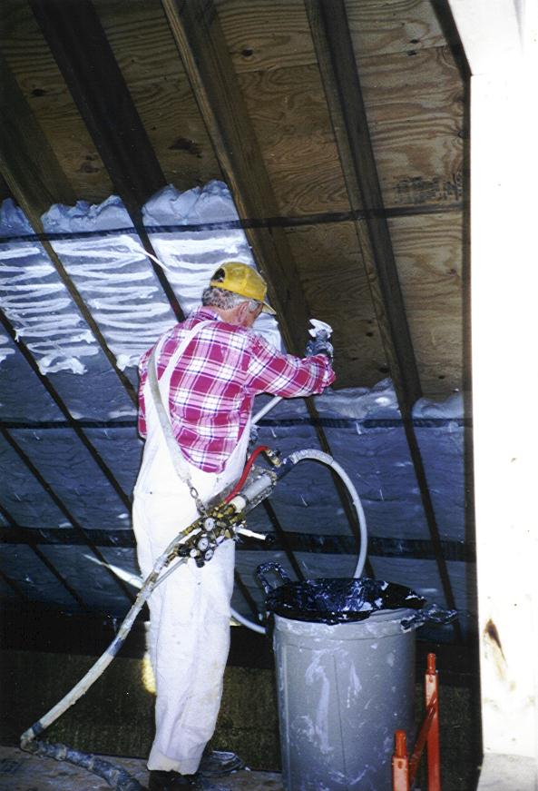
Foam Insulation Being Installed in Ceiling

Slide 11
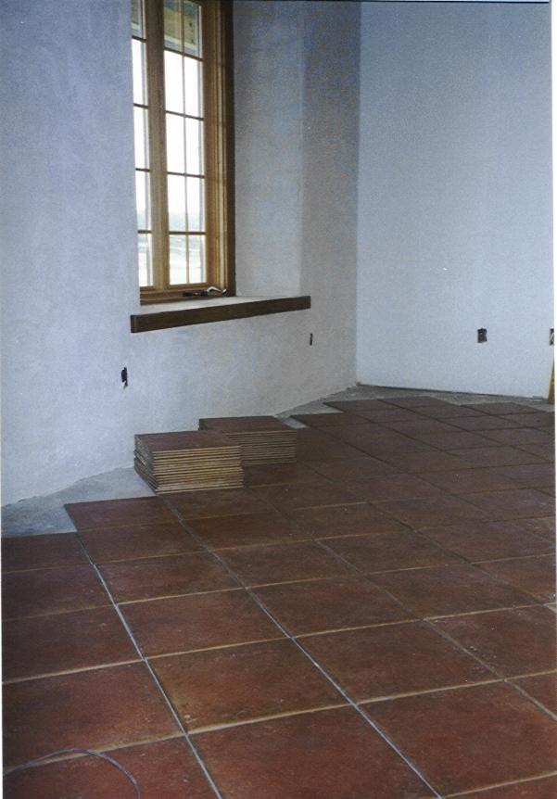
Walls and roof have plenty of “R-value,” but little thermal mass. Floor helps with that.

Slide 12
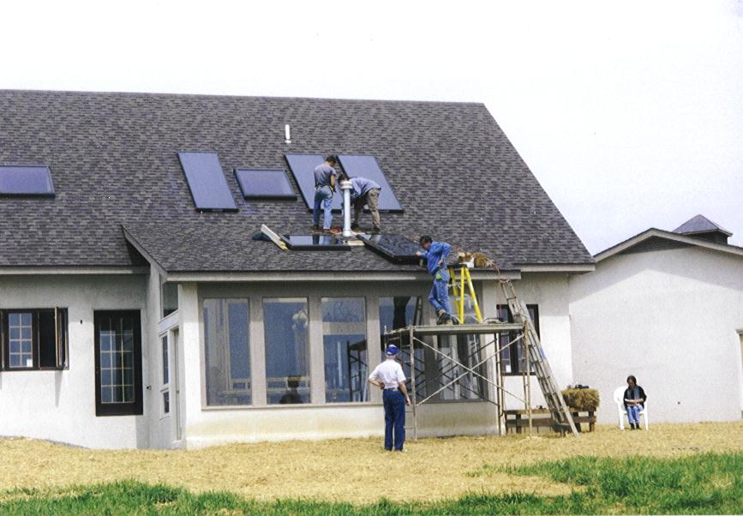

Slide 13
