Slide 1
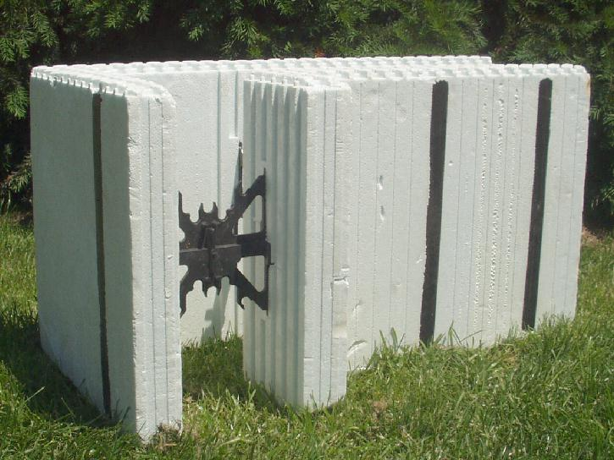
Construction of a Insulated Concrete Form (ICF)-walled Home in Amherst County, Virginia (1998)
Typical Corner Form
Spacer
For attaching interior wall treatment, e.g., drywall

Slide 2
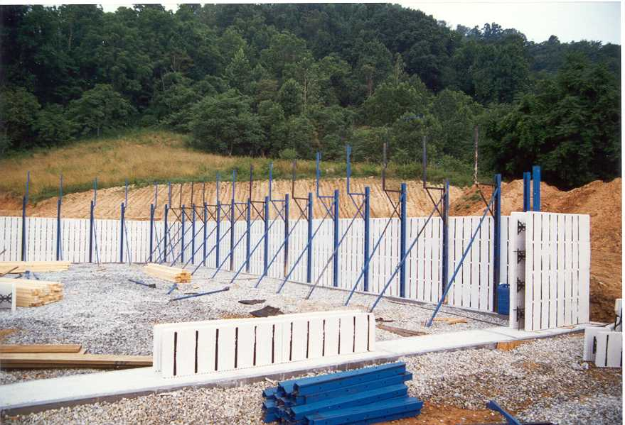
With Forms for Two Walls of Basement in Position
Note Spacers Between Inner and Outer Forms.

Slide 3
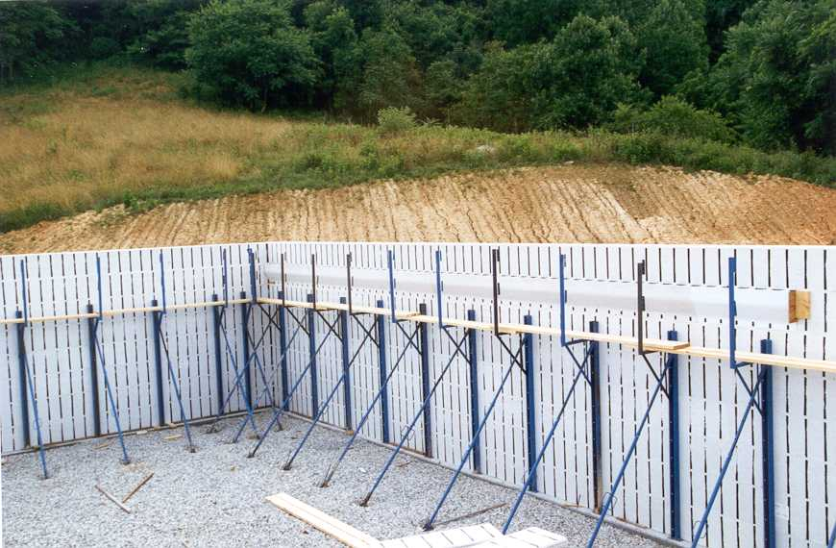
The Blue Bracing Gets Returned to the Manufacturer Once the Concrete Has Set.

Slide 4
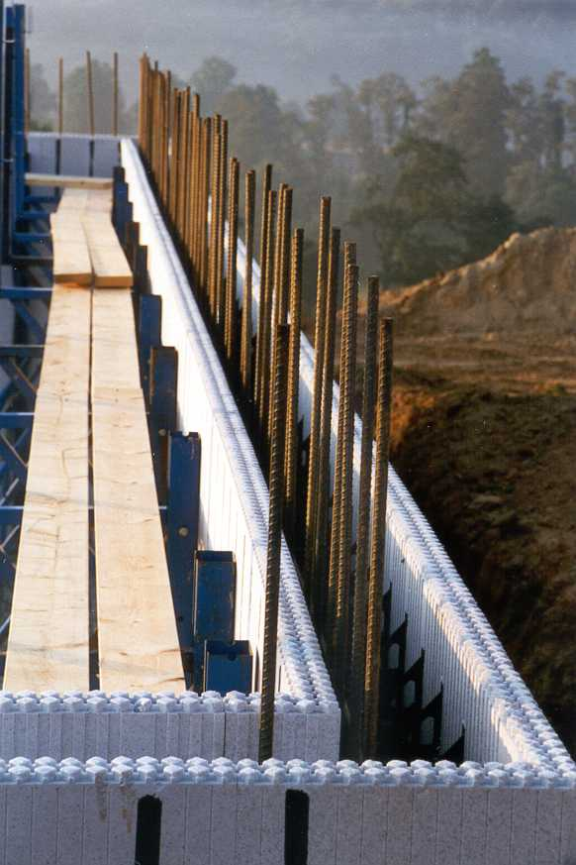
With Vertical “Rebar” in Place. The Plastic Spacers Keep Rebar In Position Until Concrete Has Set.

Slide 5
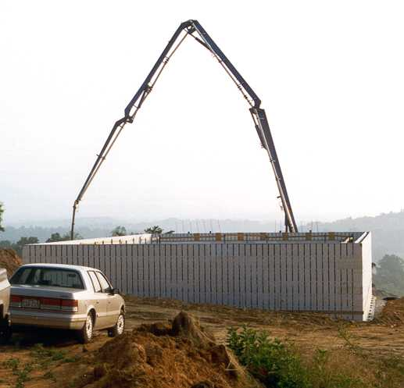
Pumping the Concrete Into the Gap between the Foam Forms.

Slide 6
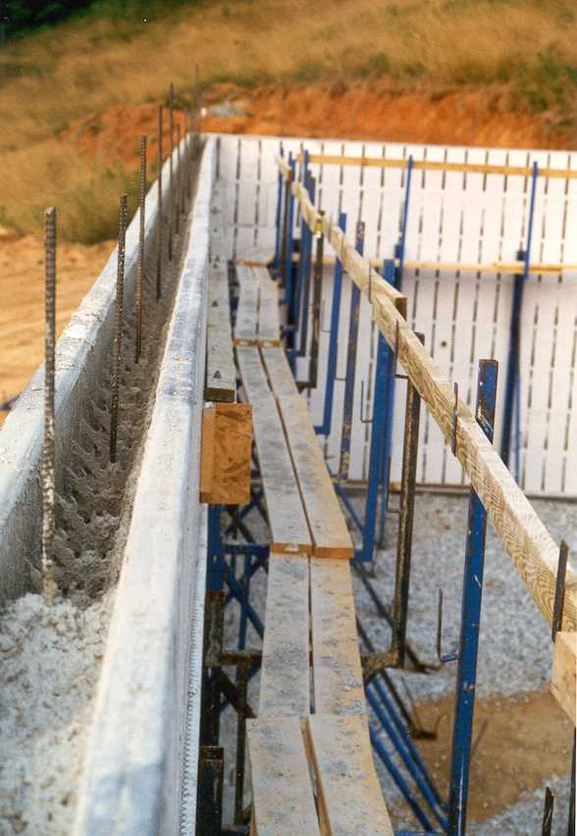
Great Thermal Resistance Both Inside and Out
With Concrete Nearly Filling the Gap
Great Thermal Mass Between Resistances

Slide 7
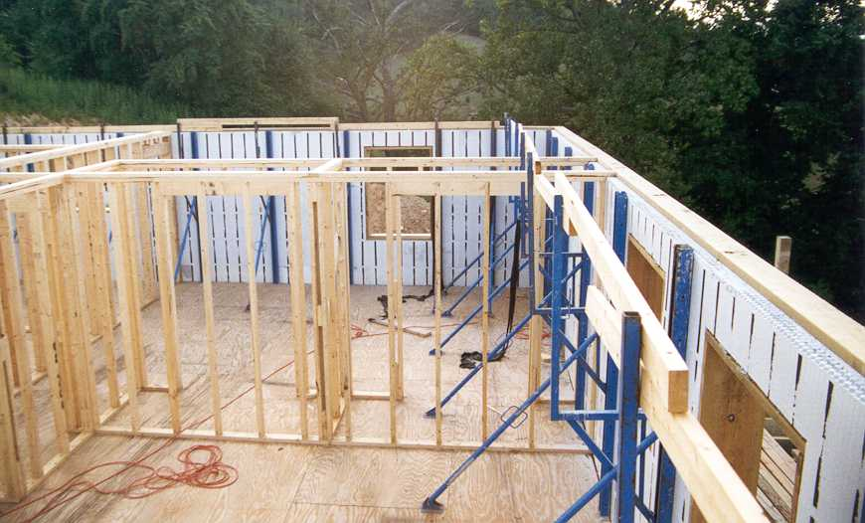
Interior Wall is Conventional 2x4 Construction

Slide 8
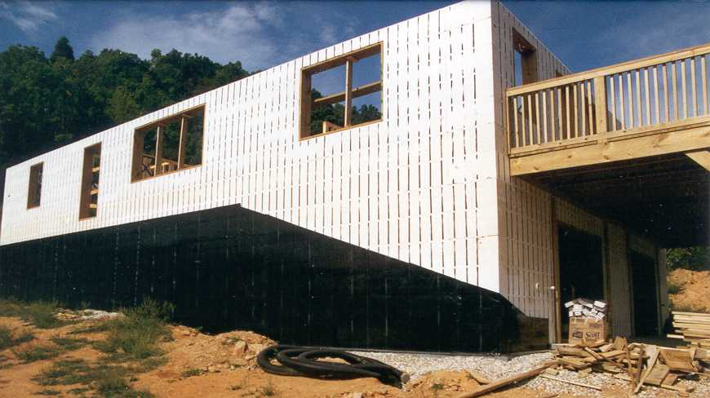
With Waterproofing on Areas That Will Be Below Grade

Slide 9
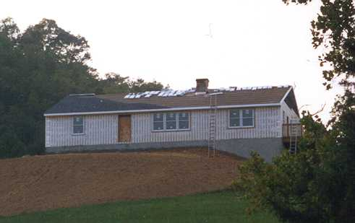

Slide 10
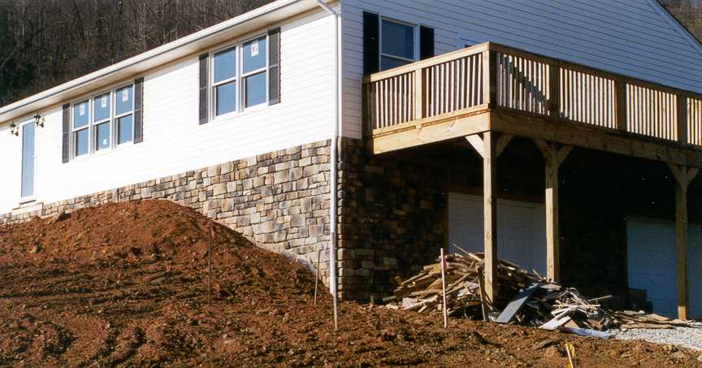
With Siding and Stone Veneer

Slide 11
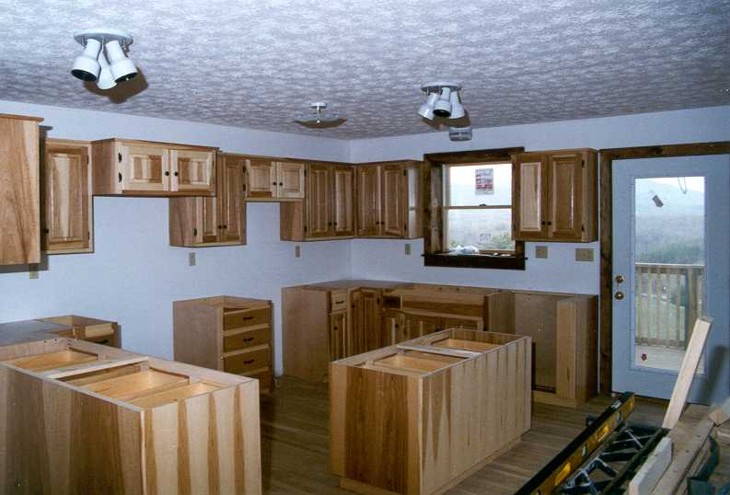
Kitchen Cabinets in Place. Note the Deep Window Sills

Slide 12
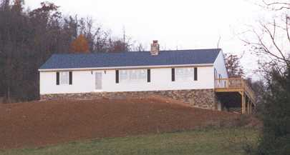
Nearly Completed Home

Slide 13
24-Hour Simulation of an ICF Wall
Note that the Styrofoam on the Outside Follows the Diurnal Cycle Very Closely (It Has Good Thermal Resistance, but Little Thermal Mass), but the Concrete, which has High Thermal Mass (But Little Resistance), Barely Responds.

