Slide 1
Ground Source vs. Conventional Air Source Heat Pumps for Residential Use
R.J. Ribando
(Compiled between early 1990’s and present based on work done with J. Taylor Beard and Dominion Resources)

Slide 2
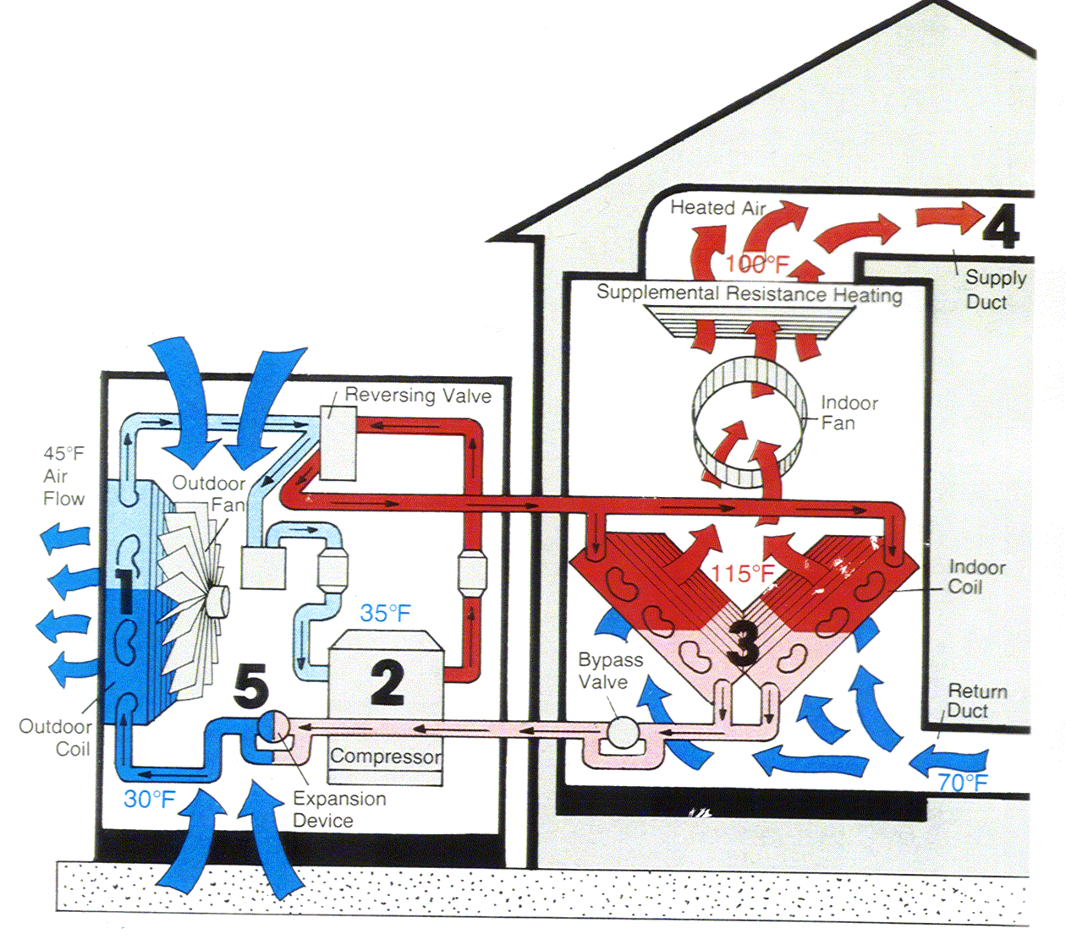
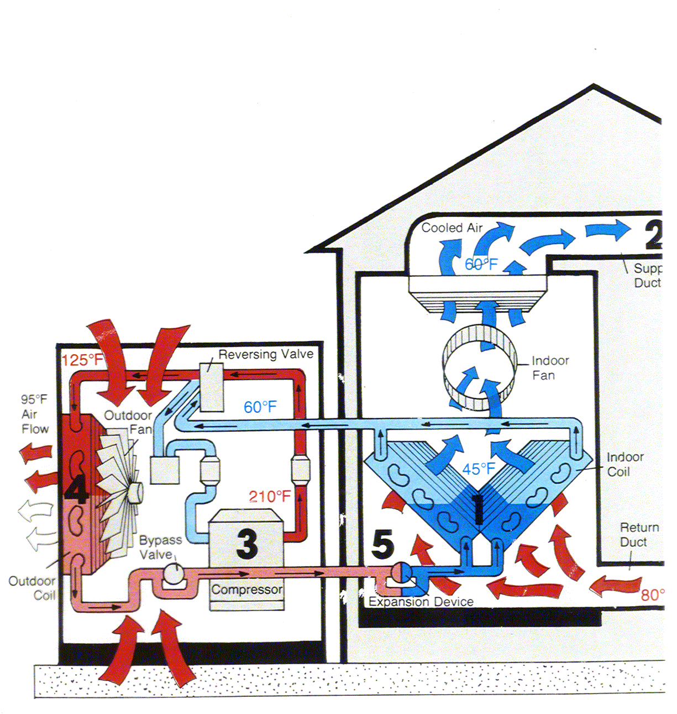
Air Source (Conventional) Heat Pump Operation
Summer Operation
Winter Operation
A Simple Split System Air Conditioning Unit Doesn’t Have the Reversing Valve Needed to Both Heat and Cool.
Source: Dominion Va Power

Slide 3
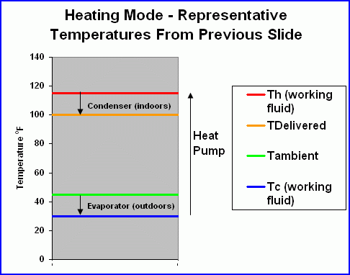
Heat Pump Basics
The work done by the compressor raises the temperature of the working fluid (refrigerant) from Tc to Th (and its pressure rises commensurately).
There must be a ΔT of 10-15ºF to transfer heat from the working fluid in the condenser to the return air inside the house and a similar ΔT between the ambient air on the outside and the working fluid in the evaporator.

Slide 4
The Coefficient of Performance (COP) Is Used to Measure Performance of Heat Pump (or any Refrigerating System)
At least it’s what we engineers use. Civilians use Seasonal Energy Efficiency Ratio (SEER).
  C.O.P. is non-dimensional.
  SEER has units of [BTU/hr/W].
  SEER = 3.4123 BTU/Hr/W x C.O.P.
The C.O.P. is what we want (heat delivered at the higher temperature) divided by what we have to pay for (which is mostly the work done by the compressor).
Having no further information about this heat pump, we’ll consider it as an ideal (Carnot) heat pump.

Slide 5
After taking Thermodynamics you’ll understand all of this, but:
Temperatures are on an absolute scale (Rankine or Kelvin), not Fahrenheit and Celsius. Using representative values from previous slides:
This is saying that nearly 7 units of energy are delivered to your house for every unit of energy you pay your utility for! (Good deal!) This calculation has been based on an ideal (Carnot) cycle. Real heat pumps have C.O.P.’s of 3 – 4 typically.

Slide 6
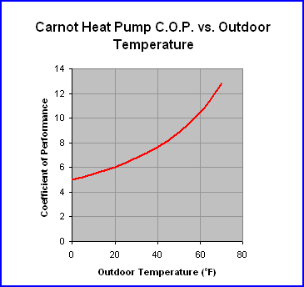
But - The C.O.P. of a conventional air-source heat pump is the lowest right when you need heating the most!
Similar calculations show the same problem during the summer. The idea of a ground source heat pump is that the temperature a few feet down stays at a relatively stable 55ºF or so (depending on your location) through the whole year. Pumping heat up from that temperature in the winter and dumping it to a reservoir at that temperature in the summer is a lot easier than coping with ambient air conditions.

Slide 7
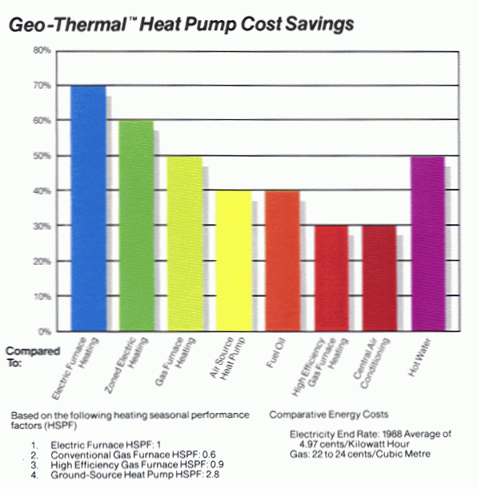

Slide 8
GROUND SOURCE HEAT PUMPS
Earth-Coupled vs. Air Source
  Seasonal vs. Daily Variations
  Conduction heat transfer in the ground vs. Convection to ambient air.
  No defrost cycle required
  Favorable (moderate) earth temperatures
Configurations
  Vertical Wells
  Horizontal Trenches (new construction only)
    Linear Pipes
    Slinky

Slide 9
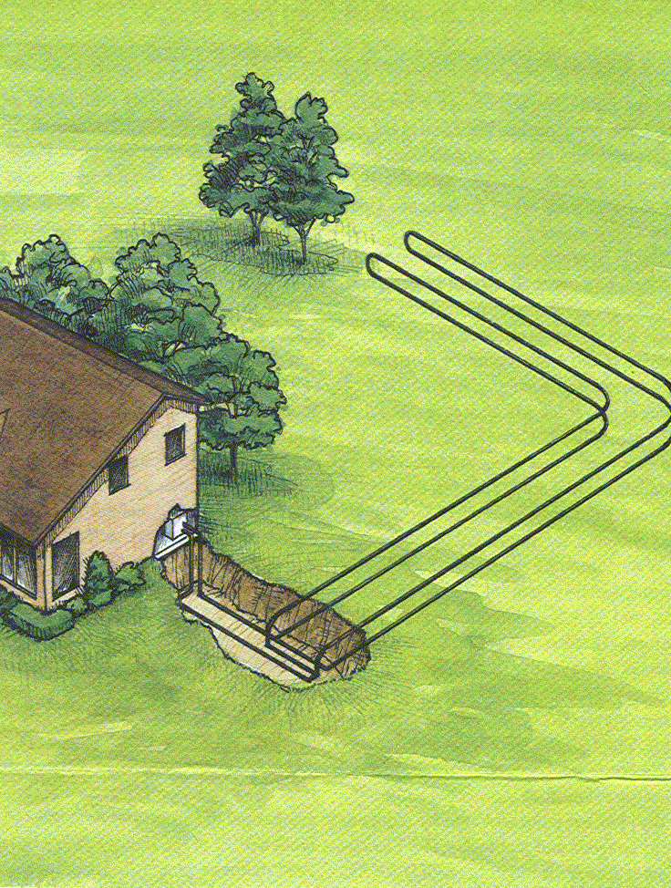
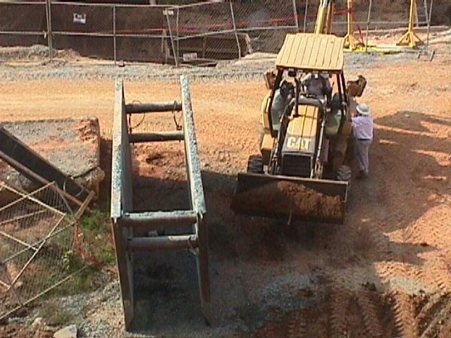
Horizontal Piping System
Suitable for new construction only – really tears up your lawn!
Trenches < 6’ deep, otherwise would need expensive shoring during work.

Slide 10
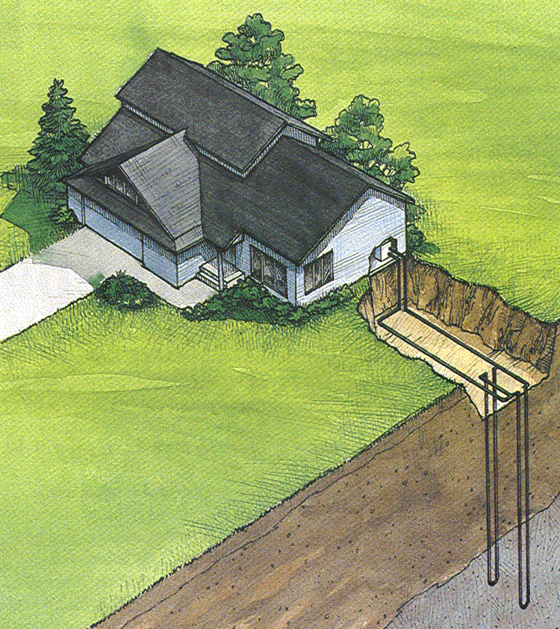
Vertical System for Residential Use – Wells are 100' or more deep.

Slide 11
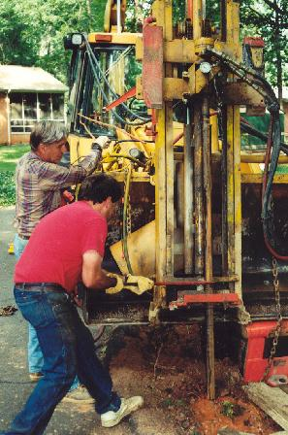
Three 100' Deep Vertical Wells Being Drilled at Beard Residence, Charlottesville, VA
June 1999

Slide 12
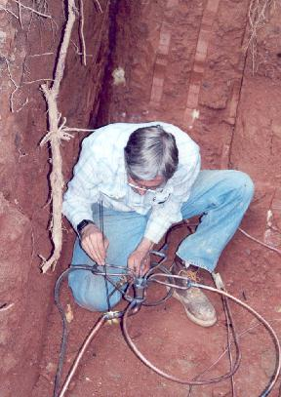
DX Coil with Equal Flow in 3 Parallel Circuits Being Installed at Beard Residence

Slide 13
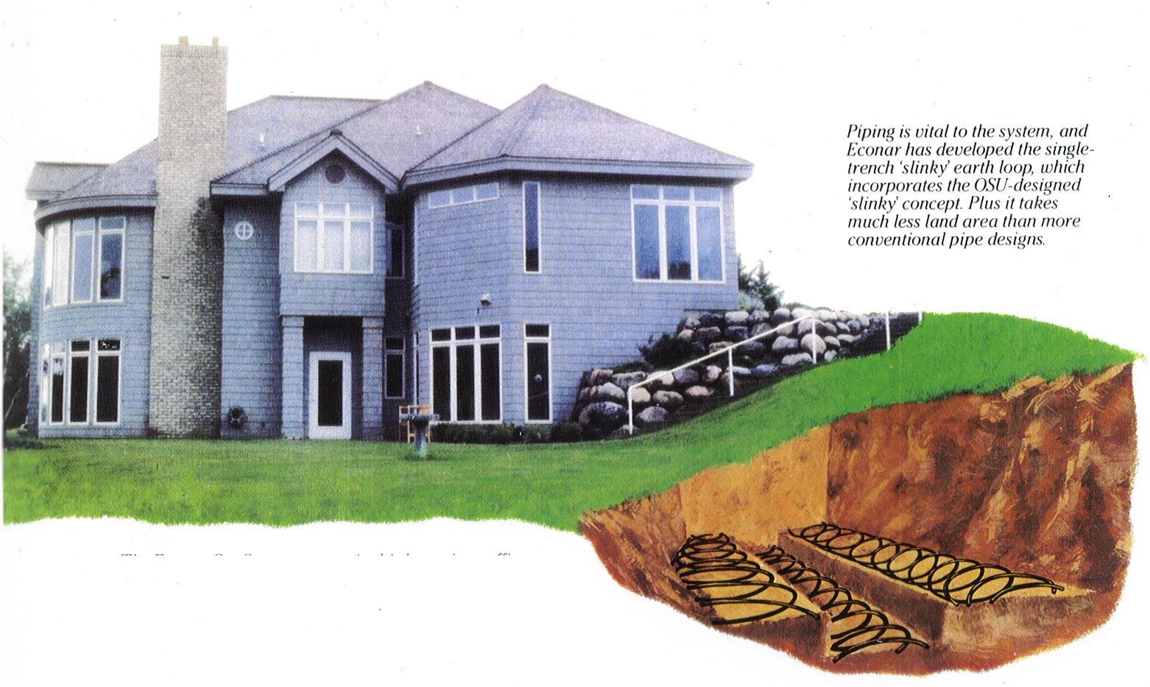
Horizontal Slinky^{tm} System

Slide 14
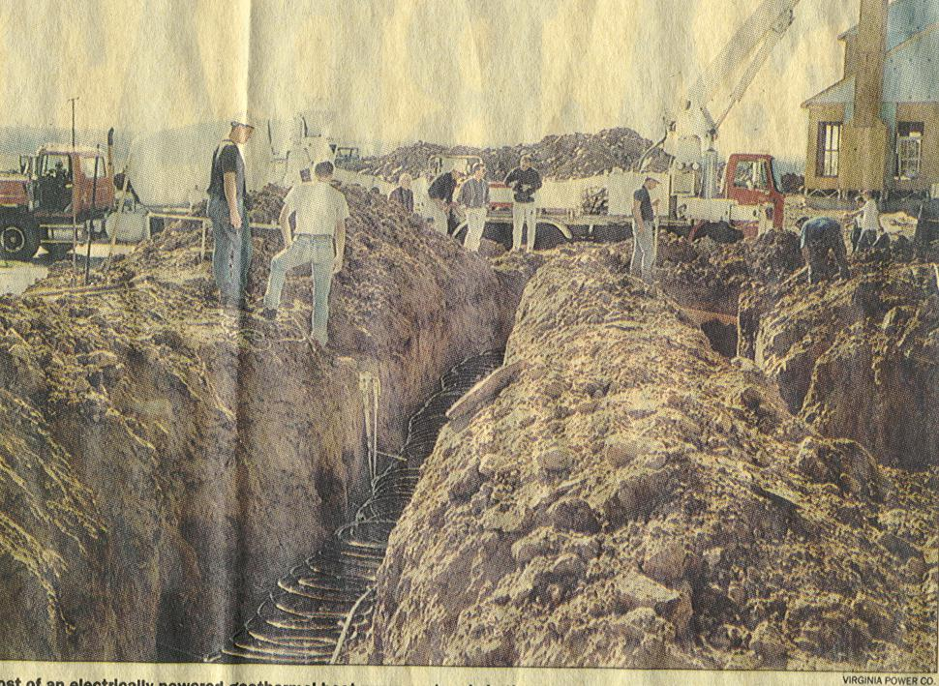
Residential Slinky Installation @ Potomac Crossing, near Leesburg, VA

Slide 15
Four Highly-Instrumented Homes Used in 1995 Va Power Study
Charlottesville (Lake Reynovia)
  Six Horizontal Straight Pipes encircling house
Leesburg – Horizontal Slinky
Powhatan – Vertical Slinky
Backfill is “flowable fill” made using Va Power fly ash from coal-fired power plants. Better thermal conductivity than native soil. Doesn’t shrink and pull away from buried pipes when dried out in the summer.
6'

Slide 16
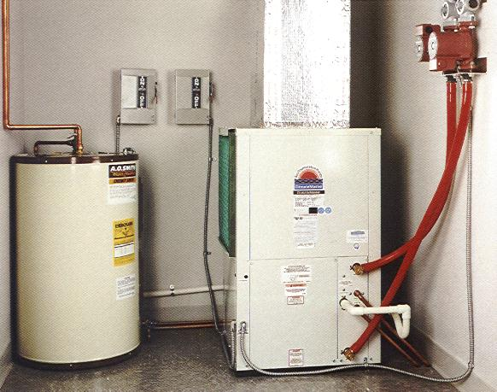
All Equipment indoors out of the Elements – No Defrosting Necessary, No Cold Starts - Can Expect Service Life Comparable to That of a Refrigerator
(which is very long)
Conventional system has compressor outdoors where it has to start up and operate in very cold conditions.

Slide 17
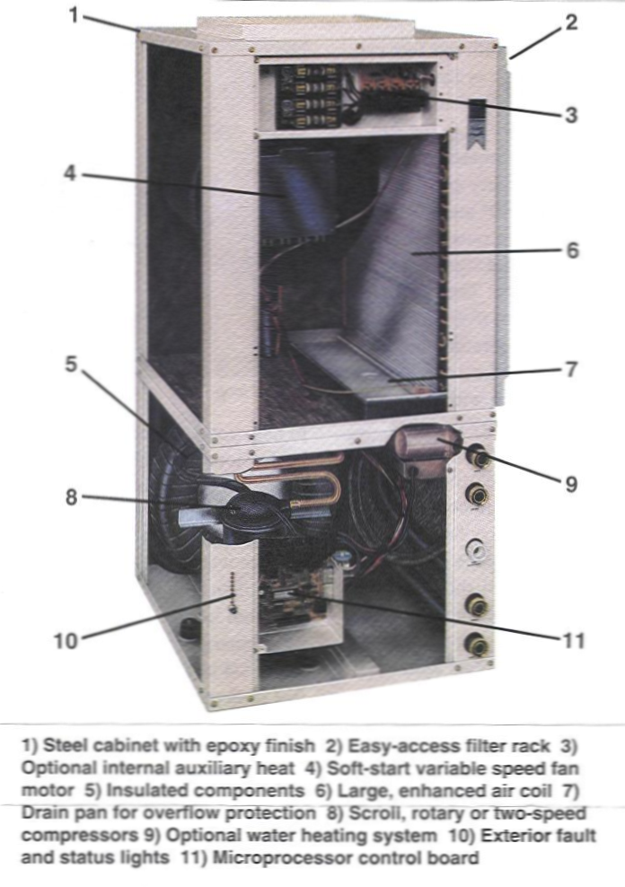
Innards of Indoor Part of GSHP System

Slide 18
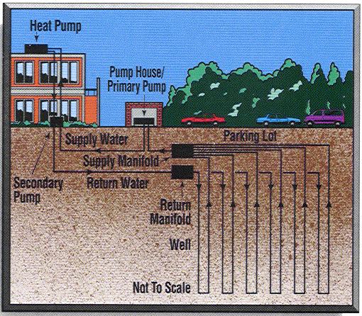
Institutional Use – Richard Stockton College of NJ
(near Atlantic City)
Hodgepodge of HVAC Systems Was Replaced with Campus-wide Ground-Source Heat Pump System

Slide 19
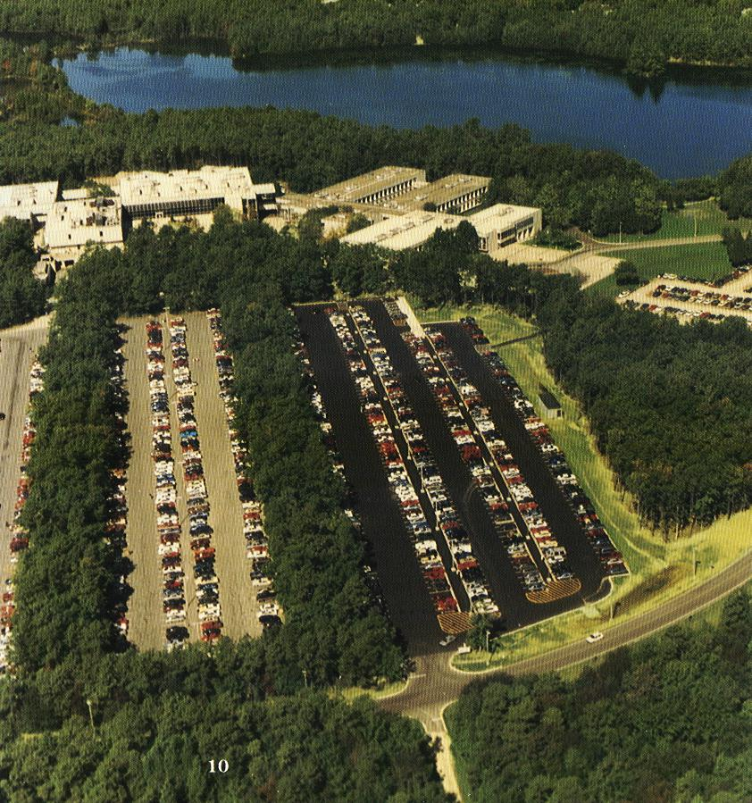
400 Wells – each 400’ deep and on 20’ centers under the recently-paved parking lot in center. Acts as thermal “battery” storing heat removed in summer for use the following winter.

Slide 20
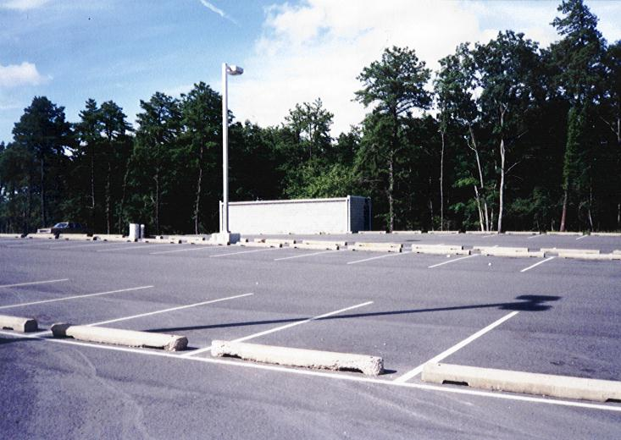
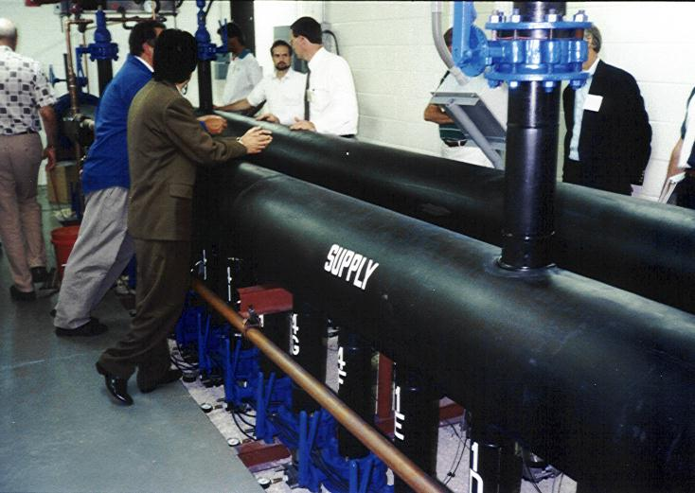
The Pump House

Slide 21
How did they choose the 20’ spacing for the wells, i.e., do they interfere with each other?
The fluid being pumped down and back up the pipes transfers heat to the inside walls of the pipes by convection.
The heat is transferred through the walls of the pipes by conduction.
The heat is transferred from the outside surface of the pipes to the surrounding earth also by conduction.
Convection is relatively fast (the fluid in the pipes is being pumped), but conduction is generally relatively slow.

Slide 22
Take a Heat Transfer course and you’ll learn how to make a simple “back-of-the-envelope calculation to determine typical conduction time and length scales.
Say that for six months you are adding heat to the ground (in each well) and then for the next six, you are pulling it back out.
How far the resulting pulse will penetrate into the ground before switching directions (because you’ve switched from heating to cooling or vice-versa) depends on a material property called the thermal diffusivity. The thermal diffusivity is the thermal conductivity divided by the density and specific heat of the material.
This simple calculation shows a characteristic length of about 1.5 m (5 ft) for a typical soil, about 2 m (6 ft) for sand and about 4.5 m (15 ft) for granite. Richard Stockton is near the Atlantic shore, and so somewhere between soil and sand is probably a good estimate.

Slide 23
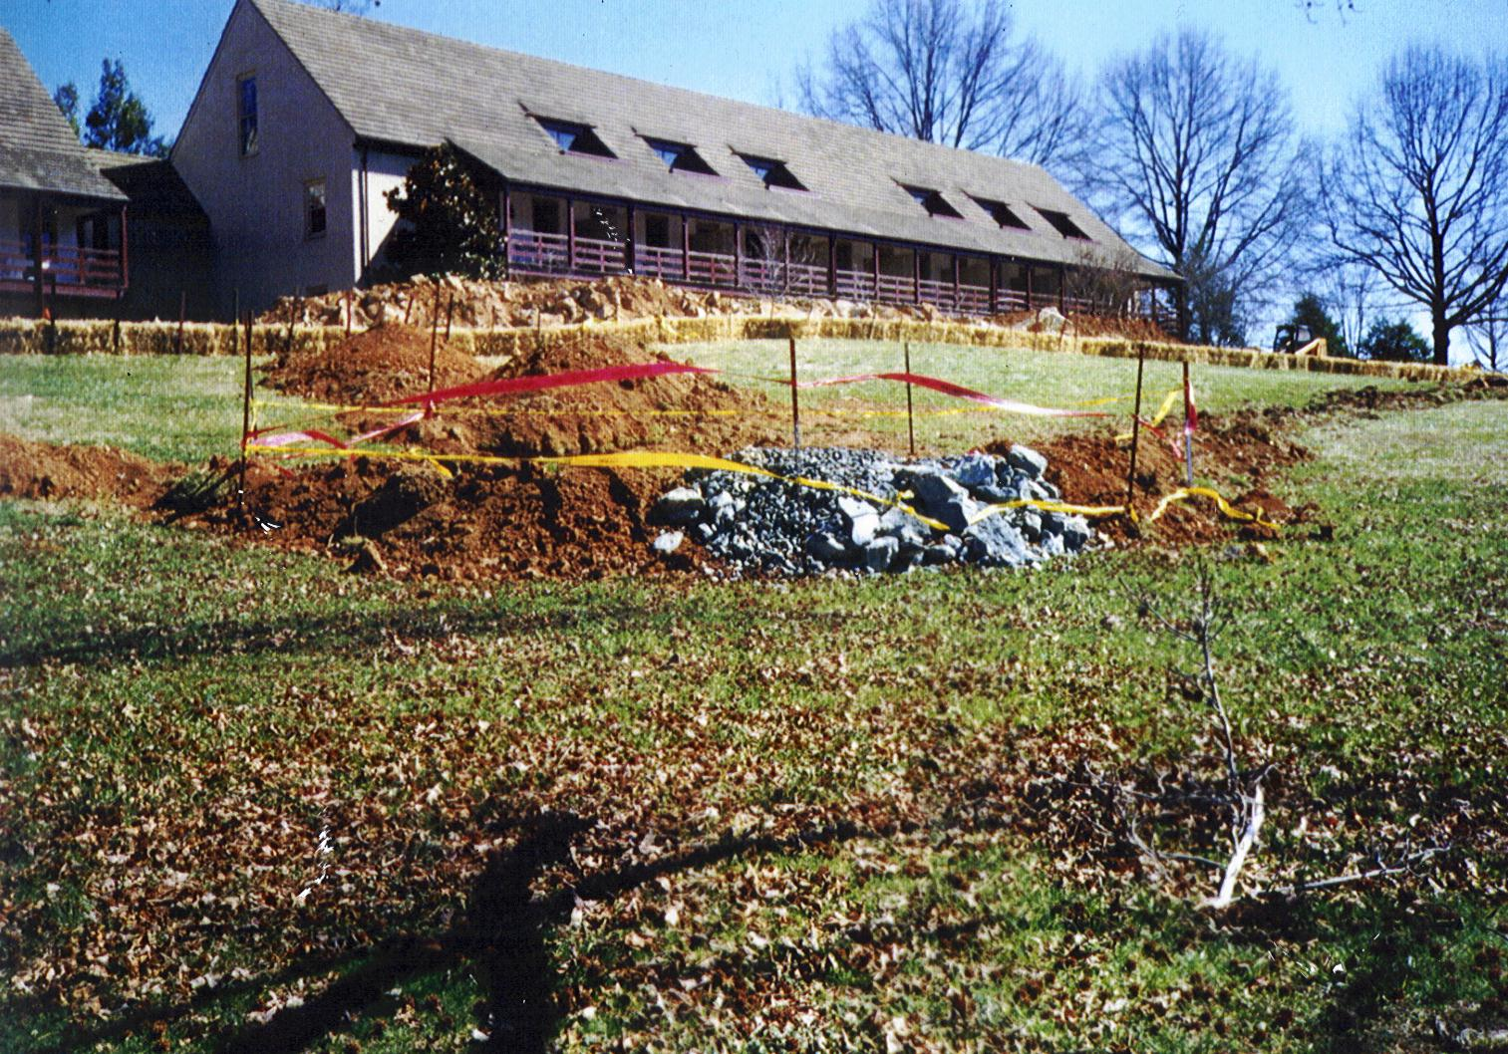
No noisy, ugly outdoor equipment – great aesthetics – Used for part of Boar’s Head Inn, C’ville and for cooling ~ 80 historic buildings at Williamsburg, VA

Slide 24
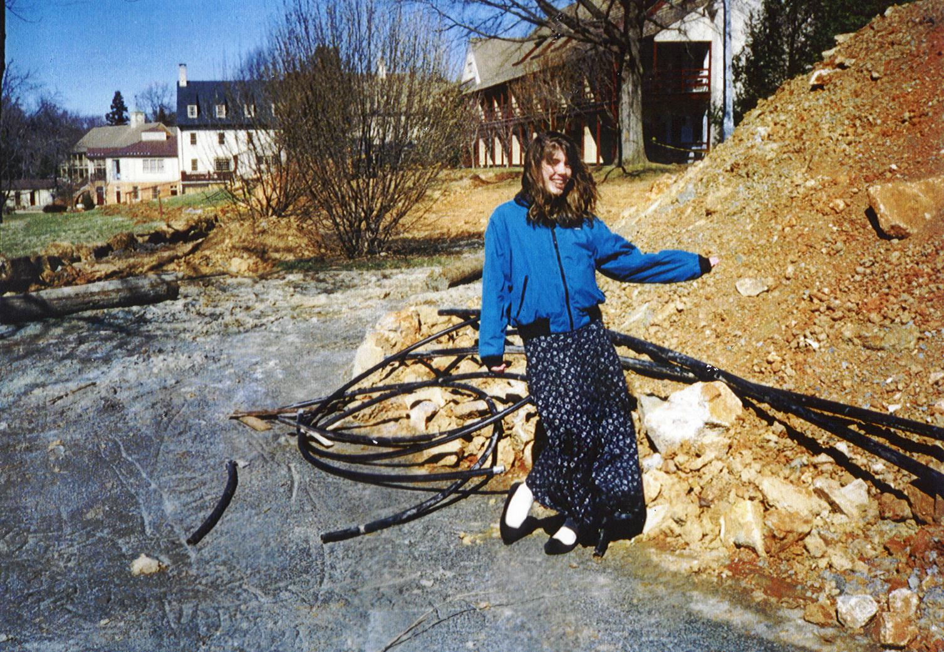
Boar’s Head Inn, Charlottesville

Slide 25
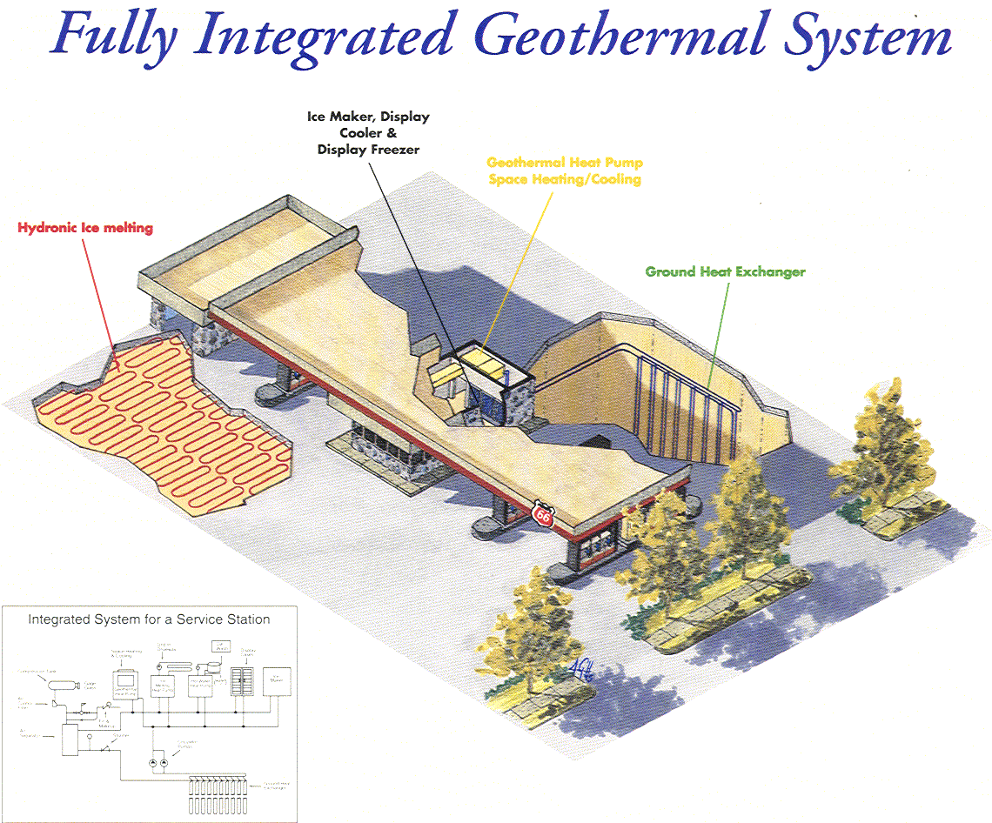

Slide 26
In an Institutional Setting, Separate Control for Each Space!
Separate, small capacity heat pump used for each space, e.g., a classroom in school. (Means temperatures can be controlled individually, e.g., if one person was using one classroom on a Saturday).
Any servicing can be done by nominally trained HVAC technician since these are small (one – three ton) units typically used for residential applications.

Slide 27
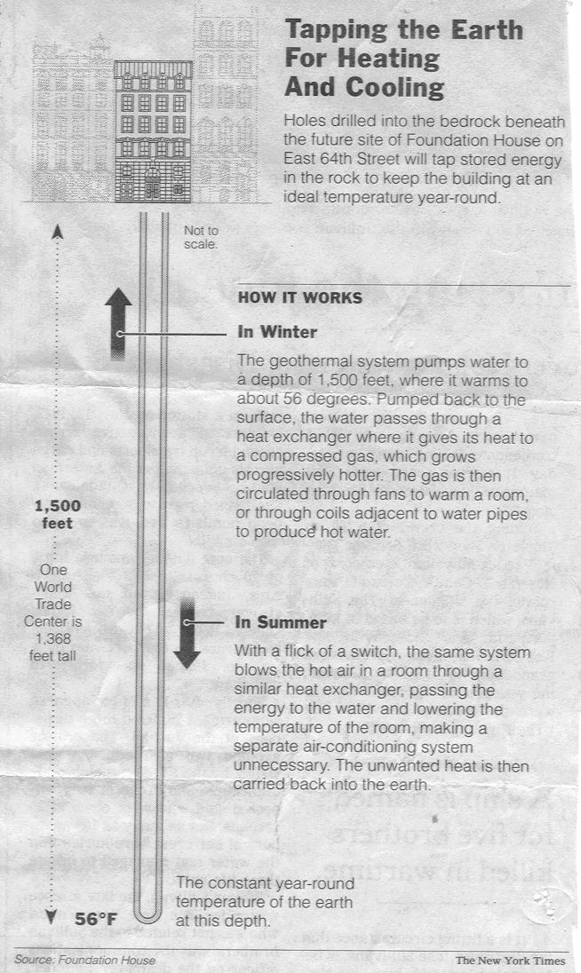
Geothermal Well bored 1500' feet into Hard Rock of Manhattan, NY
1500'

